Slide 1
Between speech and music: a look at phonetic variation in Sumtu Chin ritual chanting
SEALS
Agay, 31 May 2012
Justin Watkins
Department of Linguistics, SOAS

Slide 2
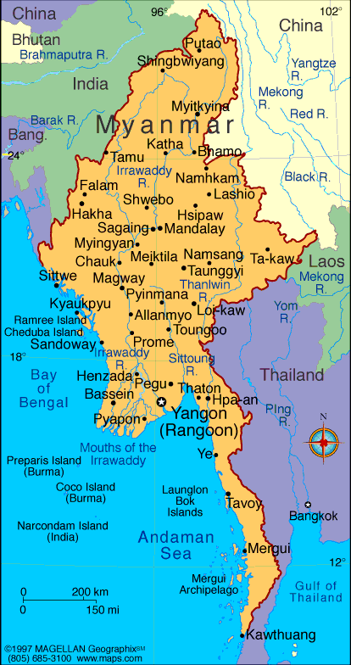
Sumtu basics
Tibeto-Burman
Kuki-Chin-Naga
Southern Chin
c. 2800 households in three townships
total speaker population probably c. 20,000
closest language to Sumtu listed in the SIL Ethnologue is Asho Chin, unintelligible to Sone-Tu speakers.

Slide 3
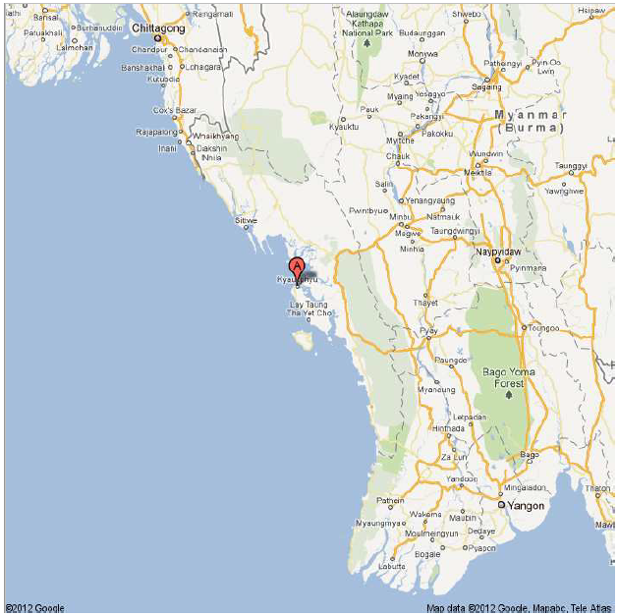
Arakan State,
western Burma/Myanmar

Slide 4
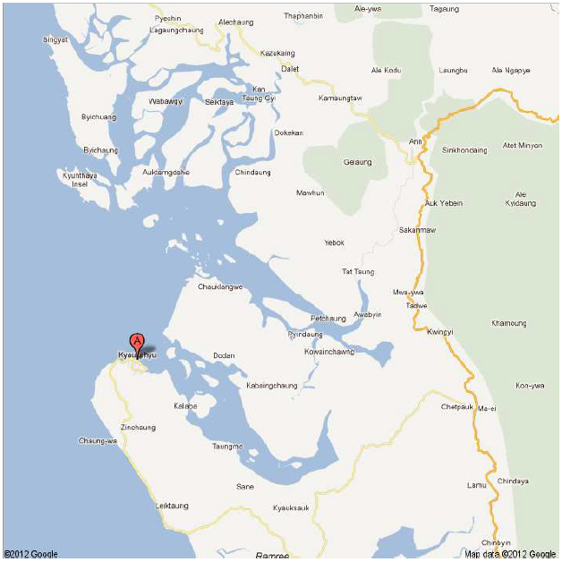
ARAKAN STATE
Kyaukphyu
Ann
Myebung
townships

Slide 5
Phonetic features of southern Chin languages
complex tone systems with intra-phrasal tone sandhi (as yet largely undescribed)
speech samples

Slide 6
Ritual Sumtu
a form of Sone-Tu unintelligible to Sone-Tu speakers
retains rich Sumtu lexicon now replaced by Arakanese/Burmese loans in the spoken language
used in animist rituals and performances
life events (births, deaths, marriages) as well as
festivals, harvests and other community occasions
now in decline
Kyaukpyu and Ann townships overwhelmingly Baptist
traditional practices survive to some extent in only in Minbya and Myebon
soon to disappear, performed only by 3 spirit mediums all over 75

Slide 7
speaker U Hla Sein ဦးလှစိန်
75 years old
from Kyaukpala village
Myebon dialect
ʨai han pɔ spirit medium
specialising in ʔəɕjam chanting for social rituals

Slide 8
Khun Yu text
House blessing ceremony
80% ritual Sumtu, 20% colloquial
about 30 minutes
Part 1: general prayer
Part 2: ritual-specific content
c. 200 lines of varying length, metre and melody
not (yet) trascribed or translated

Slide 9
investigating the text
segmented into breath phrases
mean breath 8.5s
longest 17.9s
audible deep breaths between breath phrases

Slide 10
Features of early lines
dotted rhythm (mean 2:3 ratio)
extended final syllable (c. 1:4 ratio)
monotone c. 190 Hz (F#3) on long sylls
pitch diversions on some shorter sylls
falls from a perfect fifth higher
rises from a fourth lower

Slide 11
Features of later lines
Punchier, sounds ‘urgent’ –a lot more story to get through
extended final syll / rise + glottal (end of text section?)
Sometimes abandons rhythm, hurrying up

Slide 12
Next steps
transcription / translation
establish function of phonetic features
performance effect
content-related
dictated by structure of text
part of memorisation process

Slide 13
Further research
Status of chanted texts
between speech and music
Between ethnomusicology / linguistics / anthropology
Much work remains

Slide 14
Thanks ကျေးဇူး
Mai Ni Ni Aung မိုင်နီနီအောင်
Hans Rausing Endangered Language Project – Small Research Grant SG0146

